Slide 1
Retail Sales Analysis using the Superstore Dataset
Data Analyst Internship Project
Presented By
Mandar Vijay Alhat
B.Sc. Data Science (First Year)
Symbiosis Skills and Professional University (SSPU)
Organization
LA Green Solutions
Internship Duration
1 June 2026 – 31 July 2026
Tools Used
Microsoft Excel Online
MySQL Workbench

Slide 2
Project Overview
Overview
This project was completed during my Data Analyst Internship at LA Green Solutions. The objective was to analyze the Superstore retail sales dataset using MySQL and Microsoft Excel Online to identify sales trends, evaluate business performance, and support data-driven decision-making through an interactive dashboard and business reports.
Key Highlights
Analyzed retail sales and profit data using SQL.
Built an interactive dashboard in Microsoft Excel Online.
Verified KPIs and visualizations.
Identified business insights and recommendations.
Prepared professional project documentation.

Slide 3
Project Objectives
🎯 Business Objectives
💻 Technical Objectives
Analyze retail sales performance
Identify profitable product categories
Evaluate regional sales trends
Compare sales across different states
Perform SQL-based data analysis
Build an interactive Excel dashboard
Verify KPIs and business metrics
Present insights through reports

Slide 4
Dataset Description
Dataset Information
Key Dataset Fields
Attribute | Details
Dataset Name | Superstore Dataset
File Format | CSV
Analysis Tool | MySQL Workbench
Dashboard Tool | Microsoft Excel Online
Project Type | Retail Sales Analysis
Internship | LA Green Solutions
📦 Order ID
👤 Customer Name
📅 Order Date
🌍 Region
🏙 State
📂 Category
🛒 Sub-Category
💰 Sales
📈 Profit
🚚 Ship Mode

Slide 5
Tools & Technologies
🗄️ MySQL Workbench
SQL Queries
Data Analysis
KPI Verification
📊Microsoft Excel Online
Dashboard Creation
Charts
Pivot Tables
KPI Visualization
📈Business Analytics
Sales Analysis
Profit Analysis
Regional Performance
Business Insights
📑Documentation
Executive Summary
Project Report
Project Documentation
Recommendations

Slide 6
Project Methodology
📂 Dataset
Superstore CSV
Retail Sales Data
🗄 SQL Analysis
Data Exploration
SQL Queries
Sales & Profit Analysis
✅ Data Validation
Verify KPIs
Check Accuracy
Validate Results
📊 Dashboard
Pivot Tables
Charts
KPI Cards

Slide 7
Project Methodology
📂 Dataset
Superstore CSV
Retail Sales Data
🗄 SQL Analysis
Data Exploration
SQL Queries
Sales & Profit Analysis
✅ Data Validation
Verify KPIs
Check Accuracy
Validate Results
📝 Documentation
Executive Summary
Project Report
Recommendations
💡 Business Insights
Sales Trends
Regional Performance
Top Categories
📊 Dashboard
Pivot Tables
Charts
KPI Cards

Slide 8
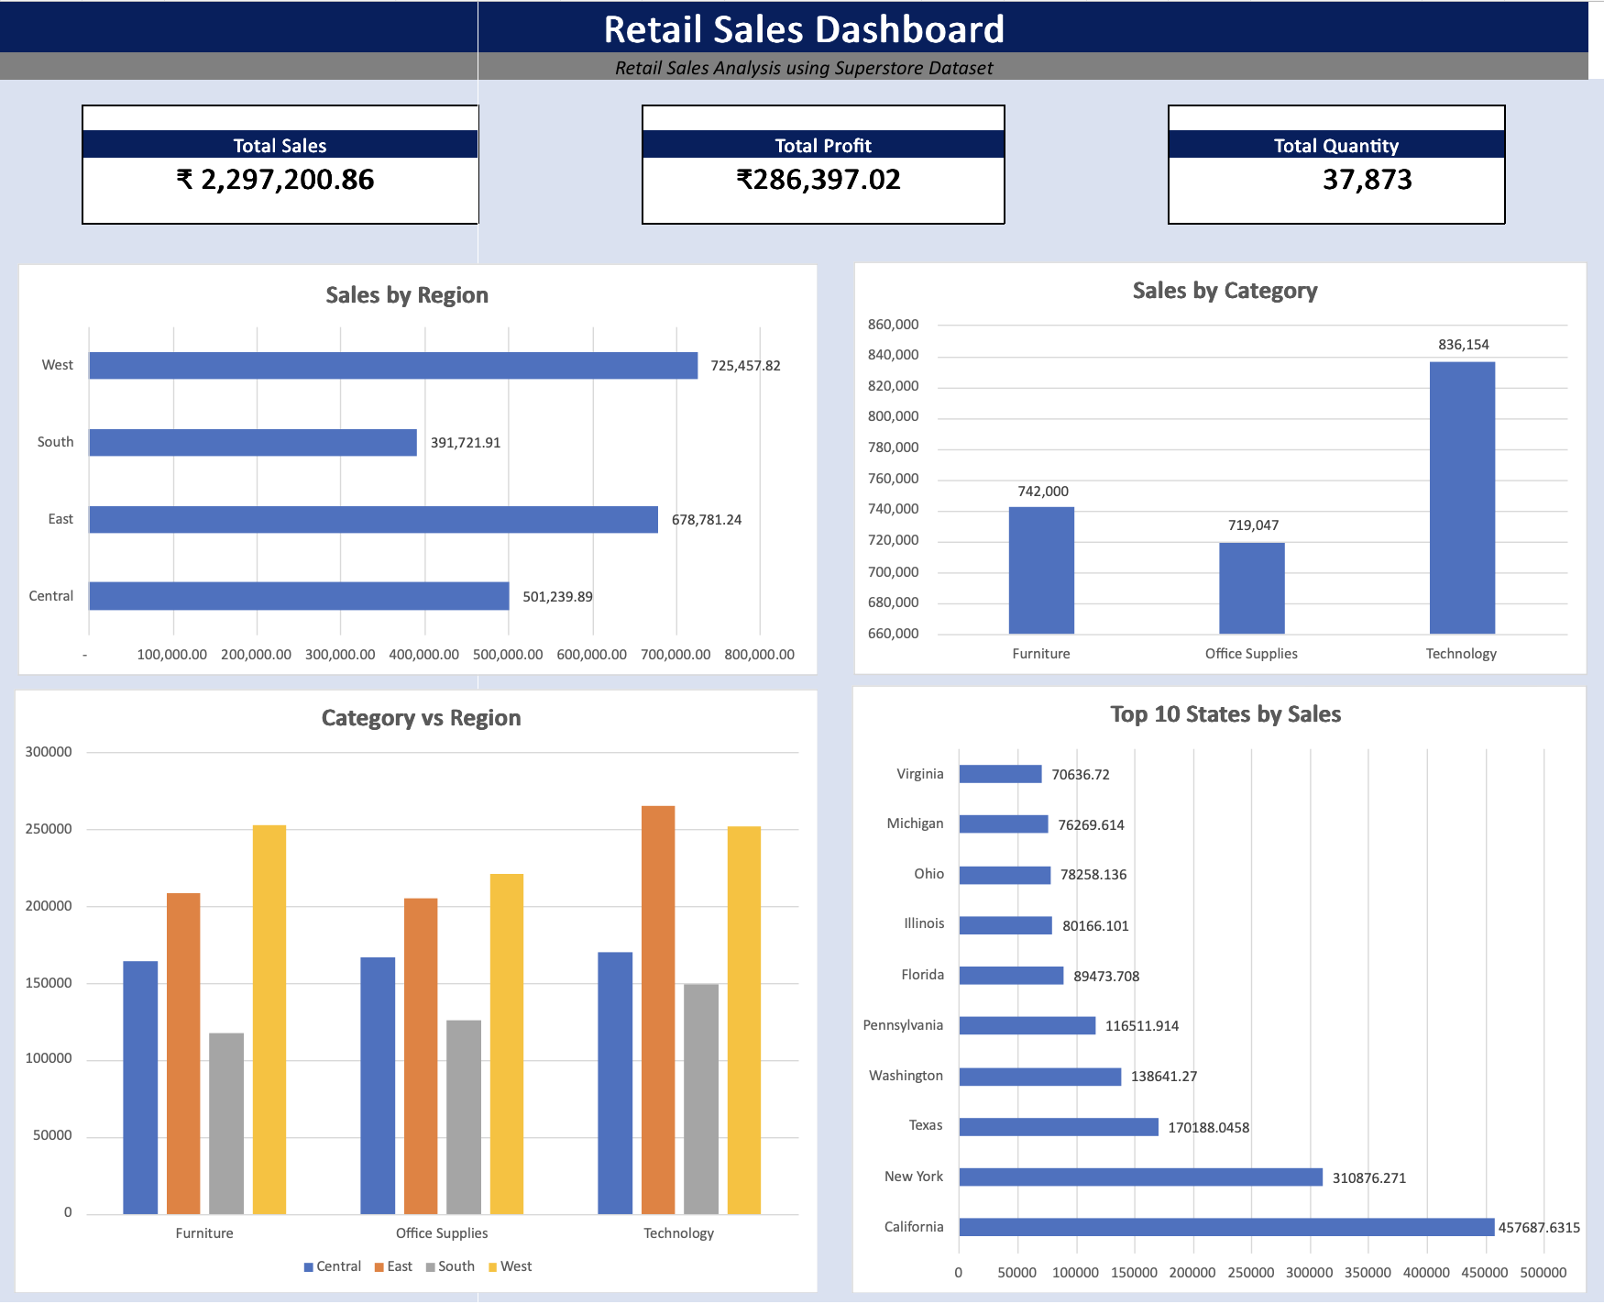
Dashboard Overview
Dashboard Features:
KPI Cards (Total Sales, Total Profit & Total Quantity)
Sales by Category
Sales by Region
Top 10 States
Category vs Region Analysis

Slide 9

SQL Analysis
SQL Queries Performed
💡 Business Insights
Total Sales Analysis
Total Profit Analysis
Sales by Category
Sales by Region
Top 10 States by Sales
Category vs Region Analysis
Order Quantity Summary
KPI Verification Queries
Technology generated the highest sales.
West region recorded the highest revenue.
California was the top-performing state.
Sales and profit trends were verified.
SQL results matched Excel dashboard KPIs.
Data accuracy was confirmed before visualization.

Slide 10
Key Business Insights
📈 Sales Insights
Technology category achieved the highest sales.
West region generated the highest revenue.
California recorded the highest sales among all states.
Office Supplies had comparatively lower sales.
Dashboard KPIs were successfully validated using SQL analysis.
💡 Business Recommendations
Focus marketing on Technology products.
Strengthen sales in South and Central regions.
Improve performance in lower-selling categories.
Continuously monitor KPIs using interactive dashboards.
Use SQL validation before reporting business metrics.

Slide 11
Conclusion
📋 Project Summary
🏆 Project Outcome
Successfully analyzed the Superstore retail dataset.
Performed SQL-based sales and profit analysis.
Developed an interactive Excel dashboard.
Verified KPIs using SQL queries.
Generated actionable business insights.
Improved understanding of retail sales performance.
Identified top-performing categories and regions.
Demonstrated practical SQL and Excel skills.
Created an easy-to-understand business dashboard.
Completed a real-world data analytics project.

Slide 12
Future Scope
📈 Future Enhancements
🚀 Skills Gained
Develop the dashboard using Power BI or Tableau.
Connect the dashboard to a live database.
Add sales forecasting using machine learning.
Automate report generation.
Create interactive web-based dashboards.
SQL Query Writing
Data Cleaning & Validation
Excel Dashboard Development
Data Visualization
Business Analytics & Reporting

Slide 13
Thank You!
Thank you for your time and attention. Questions & Discussion
Presented by
Mandar Vijay Alhat
B.Sc. Data Science (First Year)
Symbiosis Skills and Professional University
Intern at LA Green Solutions

